Slide 1


GPU Programming (in CUDA)
Fall 2018
Julian Gutierrez
Session 2

Slide 2
Outline
CUDA Basics
CUDA Execution Model
Profiling Tools

Slide 3
CUDA Basics

Slide 4
CUDA Basics
The language that started the GPGPU excitement
CUDA only runs on NVIDIA GPUs*
Highest performance programming framework for NVIDIA GPUs
Learning curve similar to threaded C programming
Large performance gains require mapping program to specific underlying architecture

Slide 5
CUDA Basics
CUDA is a general purpose parallel platform
CUDA is a standard ANSI C-like language
CUDAs Application Programming Interface (API) manages:
Devices
Memory
Synchronization
Etc.

Slide 6
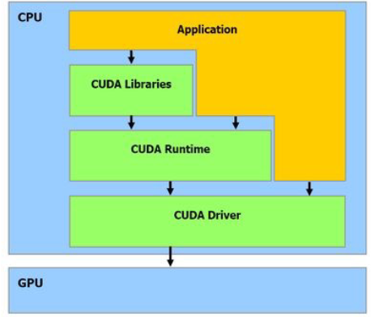
CUDA Basics
CUDAs API offers two levels:
CUDA Driver API.
Low level API, offers better control over the GPU.
CUDA Runtime API.
Higher level; implemented on top of the driver API.
We will use this API.

Slide 7
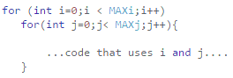
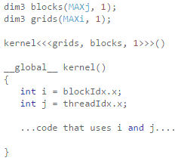
CUDA Basics
C Code
CUDA Code
Threads

Slide 8
CUDA Basics
Concepts
Host
CPU
Executes the main function and any other CPU related jobs
Device
GPU
Executes the kernel functions
CUDA Kernels: data-parallel function
A kernel is a function callable from the host and executed on the CUDA device.
The sequential code executed by each thread.
It runs “simultaneously” by many threads in parallel.
CUDA compiler: nvcc
Separates the device code from the host code during compilation process.

Slide 9
CUDA Basics
Concepts
Flow of a CUDA program
Copy data from CPU to GPU (cudaMemcpyHostToDevice)
Invoke Kernels to operate over the GPU data (asynchronous call)
Copy data back from GPU to CPU (cudaMemcpyDeviceToHost)

Slide 10
CUDA Basics
Concepts
Flow of a CUDA program
Copy data from CPU to GPU (cudaMemcpyHostToDevice)
Invoke Kernels to operate over the GPU data (asynchronous call)
Copy data back from GPU to CPU (cudaMemcpyDeviceToHost)

Slide 11

CUDA Basics
Concepts
Flow of a CUDA program
Copy data from CPU to GPU (cudaMemcpyHostToDevice)
Allocate space
Transfer data
cudaError_t cudaMalloc ( void** devPtr, size_t size )
cudaError_t cudaMemcpy ( void* dst, const void* src, size_t count, cudaMemcpyKind kind )

Slide 12
CUDA Basics
Concepts
Flow of a CUDA program
Copy data from CPU to GPU (cudaMemcpyHostToDevice)
Invoke Kernels to operate over the GPU data (asynchronous call)
Copy data back from GPU to CPU (cudaMemcpyDeviceToHost)

Slide 13
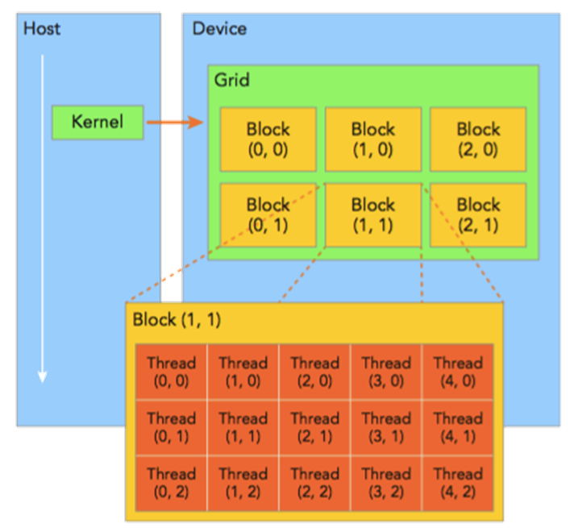
CUDA Basics
Concepts
Flow of a CUDA program
Copy data from CPU to GPU (cudaMemcpyHostToDevice)
Invoke Kernels to operate over the GPU data (asynchronous call)
Think about adding 2 vectors with a size of 1000 together:
Ai + Bi = Ci
How many threads would you ideally use?
How do you divide the number of threads?
What changes if you have a 2D array instead?
What changes if the solution requires synchronization between certain threads?

Slide 14
CUDA Basics
Concepts
Flow of a CUDA program
Copy data from CPU to GPU (cudaMemcpyHostToDevice)
Invoke Kernels to operate over the GPU data (asynchronous call)
Thread organization
A Kernel call creates a Grid.
Multiple blocks are combined to form a grid. All the blocks in the same grid contain the same number of threads.
The threads of a block can be indexed using 1 Dimension (x), 2 Dimensions (x,y) or 3 Dimensions indexes (x,y,z)
Blocks Per Grid (Grid size)
blockIdx.x, blockIdx.y, blockIdx.z
gridDim.x, gridDim.y, gridDim.z (measured in blocks)
Threads Per Block (Block size)
threadIdx.x, threadIdx.y, threadIdx.z
blockDim.x, blockDim.y, blockDim.z (measured in threads)

Slide 15
CUDA Basics
Concepts
Flow of a CUDA program
Copy data from CPU to GPU (cudaMemcpyHostToDevice)
Invoke Kernels to operate over the GPU data (asynchronous call)
How do we define the number of blocks per grid, and threads per block?
Consider the nature of the problem
Consider the nature of the GPU architecture
Use dim3 data type
dim3 block(32); dim3 grid(((nElem-1)/block.x)+1);
Grid Size is a rounded up multiple of blocks, based on the parallel architecture of the GPU

Slide 16
CUDA Basics
Concepts
Flow of a CUDA program
Copy data from CPU to GPU (cudaMemcpyHostToDevice)
Invoke Kernels to operate over the GPU data (asynchronous call)
Invocation of the CUDA kernel from host will have triple-angle-brackets:
grid*block is the total number of threads launched for the kernel.
kernel_name <<<grid, block>>>(argument list);

Slide 17
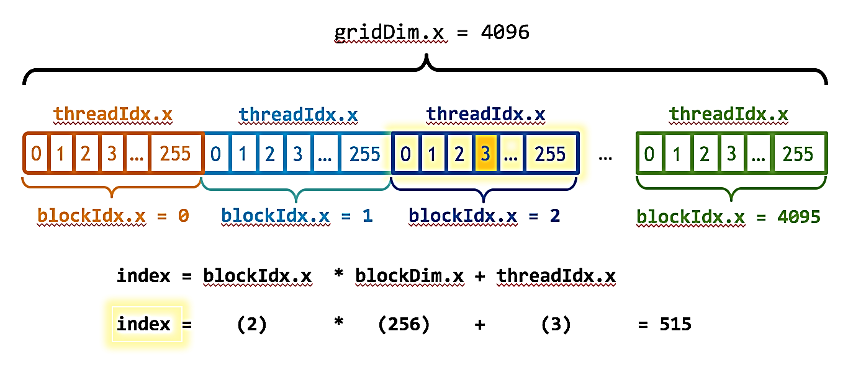
CUDA Basics
Concepts
Kernel Invocation example
How many threads are executed?
How do we tell each thread to process one unique element?
kernel_name<<<4096, 256>>>(argument list);

Slide 18
CUDA Basics
Concepts
Kernel Invocation example
How many threads are executed?
How do we tell each thread to process one unique element?
kernel_name<<<4096, 256>>>(argument list);

Slide 19
CUDA Basics
Concepts
Writing kernels:
Global qualifier (Executed on the device, Callable from the host only)
Device qualifier (Executed on the device Callable from the device only)
Some restrictions:
Use only device memory (pointers to GPU RAM)
return void
no support for variable number of parameters
It has asynchronous behavior
__global__ void kernel_name(argument list);
__device__ called from the device.

Slide 20
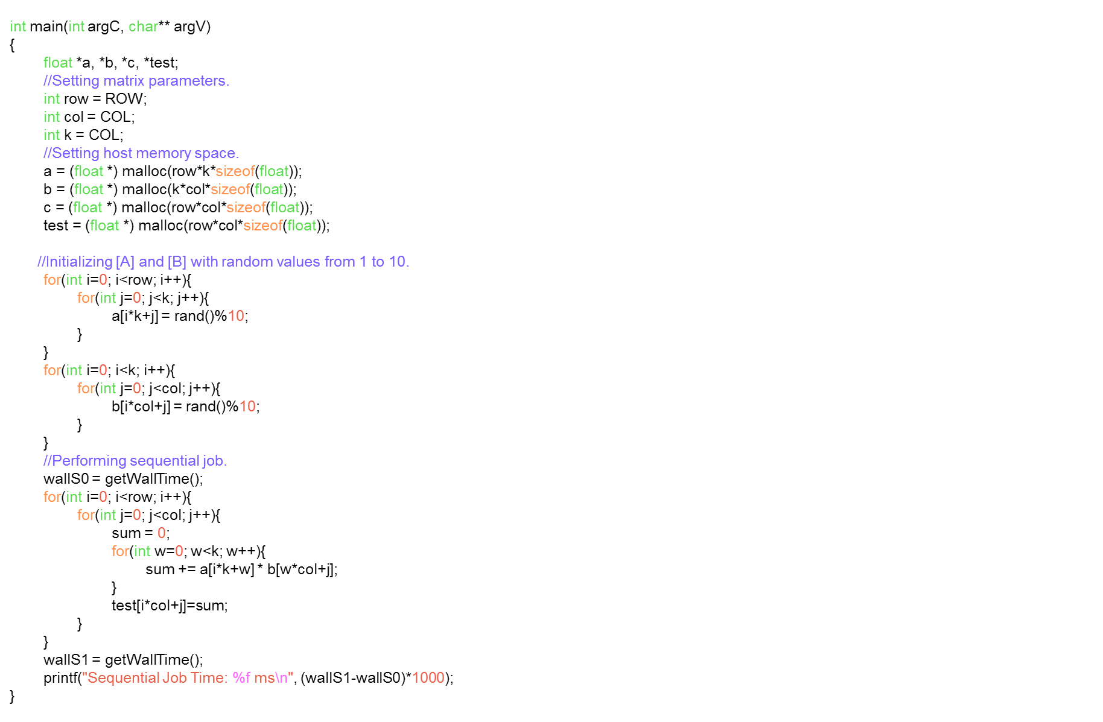
CUDA Basics
Example

Slide 21
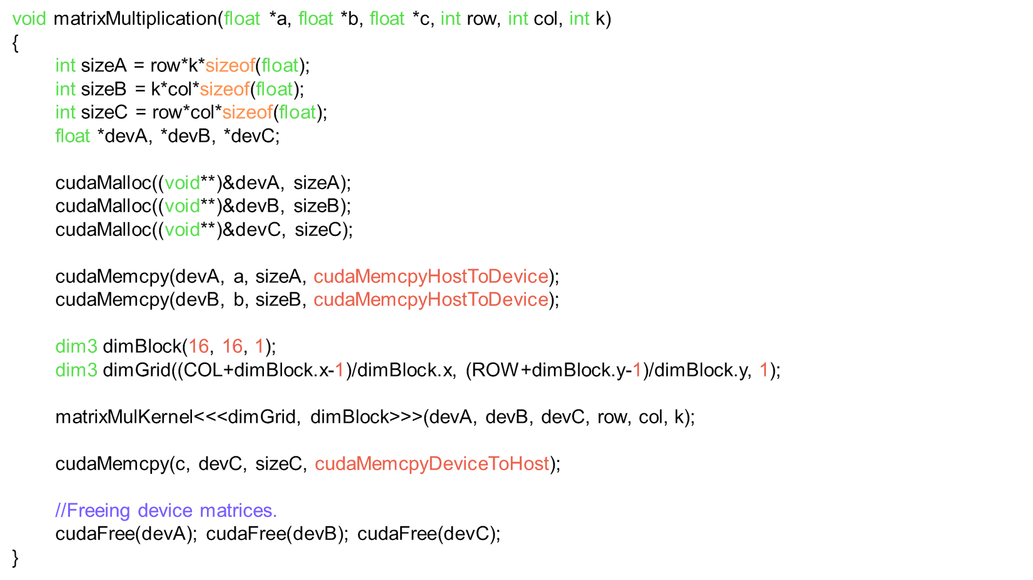
CUDA Basics
Example
Allocation on the GPU
Transfer Data CPU to GPU
Kernel Call
Transfer back to CPU

Slide 22
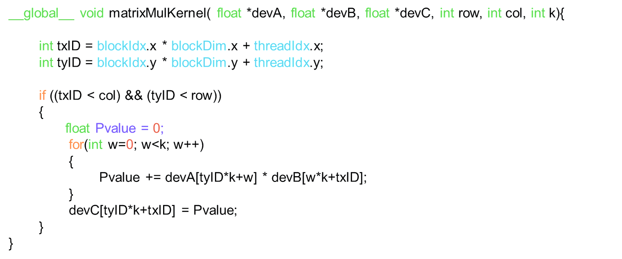
CUDA Basics
Example

Slide 23
CUDA Basics
Example
Compilation
nvcc matrixMul.cu -o matrixMul
Execution
./matrixMul
Sequential Job Time: 588.227987 ms
Parallel Job Time: 108.647108 ms

Slide 24
CUDA Execution Model

Slide 25
CUDA Execution Model
Example
Why Do we need to learn about the GPU architecture and the CUDA execution model?
To understand how to efficiently use the selected configuration
Find a guideline to choose a proper grid/block configuration
We will go over the architecture while explaining how a kernel executes on the GPU
We will focus on the Kepler architecture

Slide 26
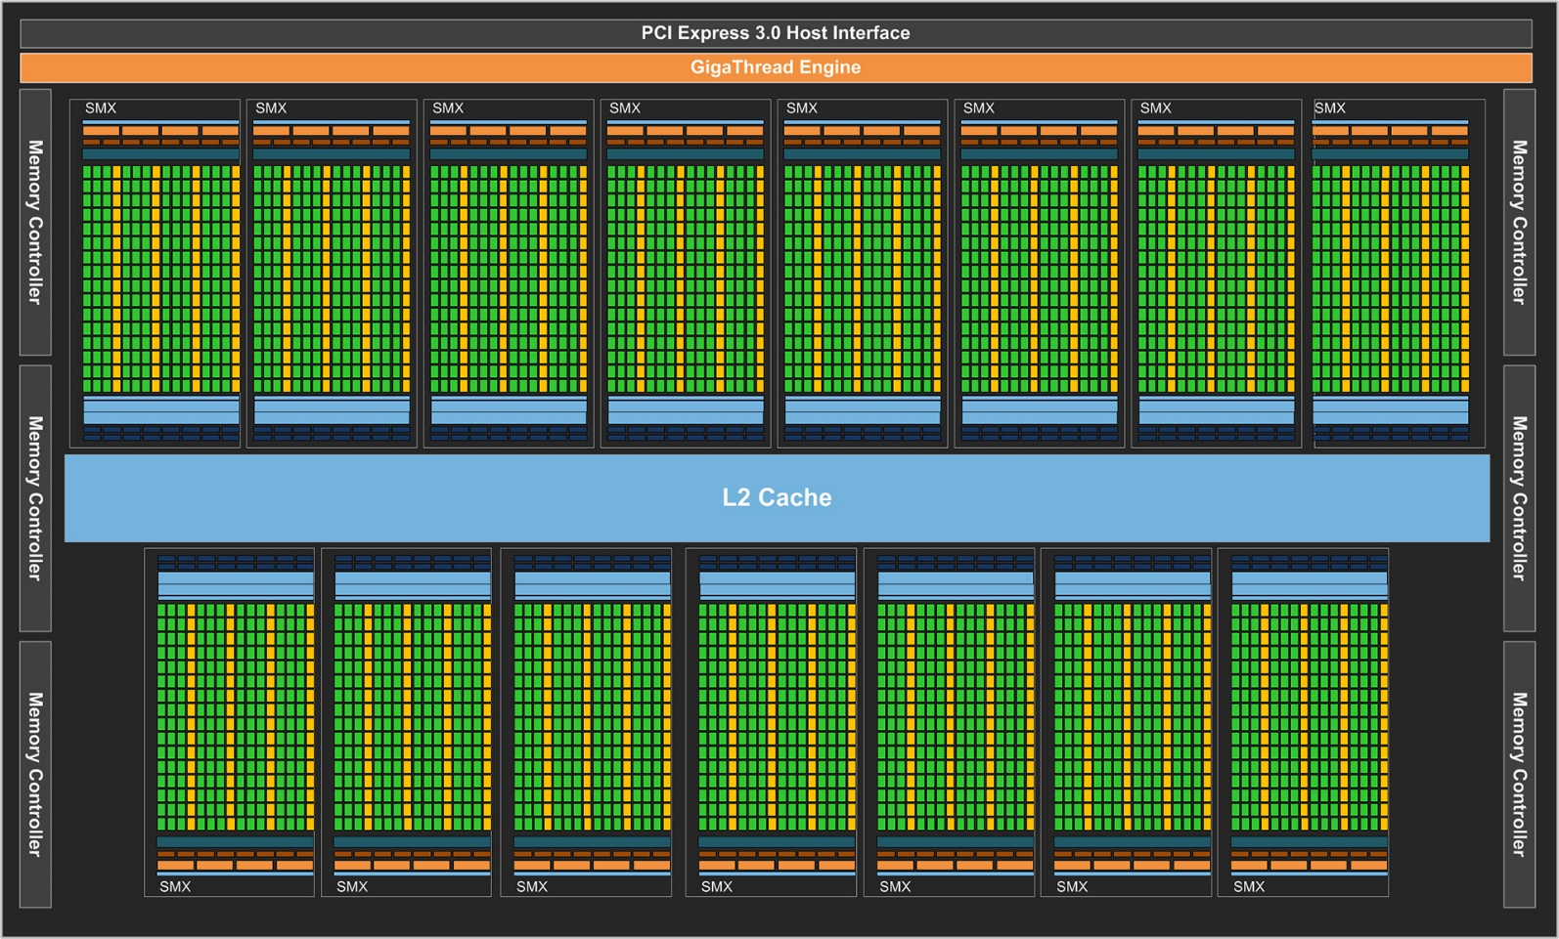
CUDA Execution Model
Kepler Architecture - SMX
The Kepler Architecture
Divided into SMXs
Contains a big L2 cache shared between all SMXs

Slide 27
CUDA Execution Model
Kepler Architecture - SMX
Scalable array of Streaming Multiprocessors
CUDA Cores
Shared Memory
Register File
Load/Store Units
Special Function Units
Warp Scheduler
Streaming Multiprocessor Extreme (SMX)
Each SM is designed to support the execution of hundreds of threads.
Kepler K40
15 Multiprocessors
Number of processors: 2880
Each SMX contains
192 CUDA cores
64 Double Precision units
32 SFU
32 load/store units

Slide 28
CUDA Execution Model
Kepler General Information
Details | Kepler GK110
Compute Capability | 3.5
Threads / Warp | 32
Max Warps / Multiprocessor | 64
Max Threads / Multiprocessor | 2048
Max Thread Blocks / Multiprocessor | 16
32-bit Registers / Multiprocessor | 65536
Max Registers / Thread | 255
Max Threads / Thread Block | 1024
Shared Memory Size Configurations (bytes) | 16K 32K 48K

Slide 29
CUDA Execution Model
Launching a Kernel
When a kernel Grid is launched:
Thread-blocks are divided among the SMs for execution.
Threads on the same blocks will be executed simultaneously (logically speaking).
Multiple blocks could be assigned to the same SM but that doesn't mean they will be executed simultaneously, it will depend on the available resources.

Slide 30
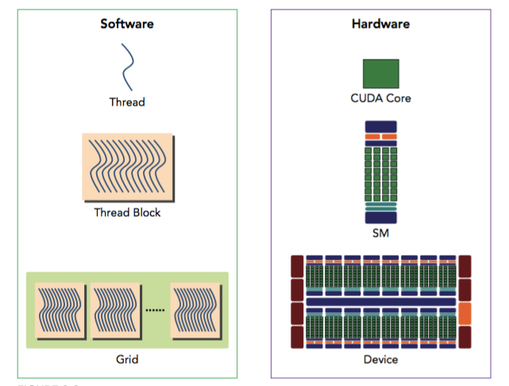
CUDA Execution Model
Logical and Physical View

Slide 31
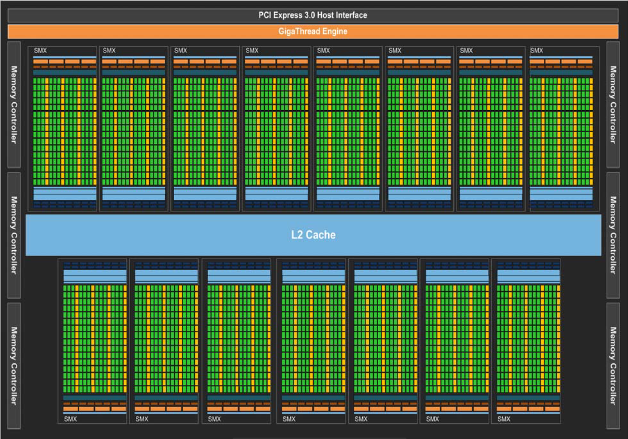
CUDA Execution Model
Launching a Kernel
kernel<<<4, 256>>>(pointer1);
256 threads
256 threads
256 threads
256 threads

Slide 32
CUDA Execution Model
Kepler Architecture - SMX
CUDA uses Single Instruction Multiple Thread (SIMT)
Threads will be grouped into warps (32 threads per warp)
All threads in a warp execute the same instruction at the same time
Each SM will partition the blocks into warps and then schedule them for execution depending on available hardware resources.
It is possible that threads on the same warp could have different behavior.

Slide 33
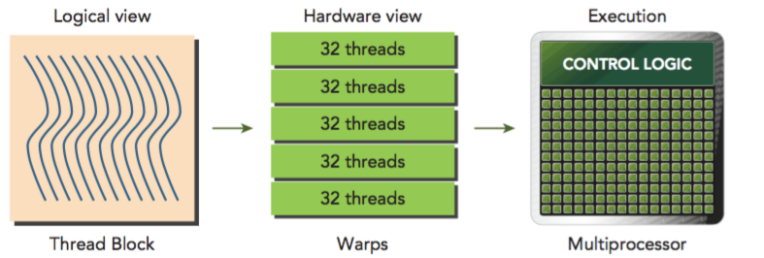
CUDA Execution Model
Warp Execution
Warp → the basic unit of execution
Each thread in a warp must executed the same instruction.

Slide 34
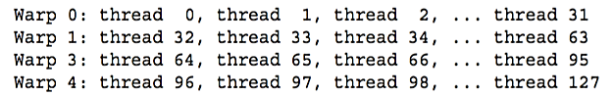
CUDA Execution Model
Warp Execution
Blocks can be 3D (x, y, and z dimension). However from the hardware point of view, we can see the threads as one dimension.
Threads are grouped into warps based on the built-in variable threadIdx
E.g. blocks of 128 threads will be partition in 4 warps as follow:

Slide 35
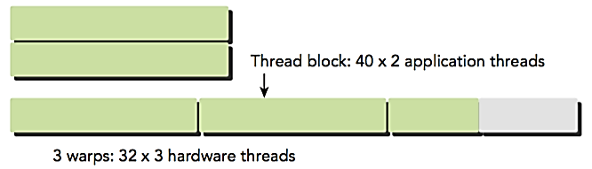
CUDA Execution Model
Warp Execution
Not taking warp size into account can lead to misuse
If your block has a certain number of threads which is not a multiple of the warp size, then threads on a warp will be wasted.
E. g. a threadBlock of 80 threads.

Slide 36
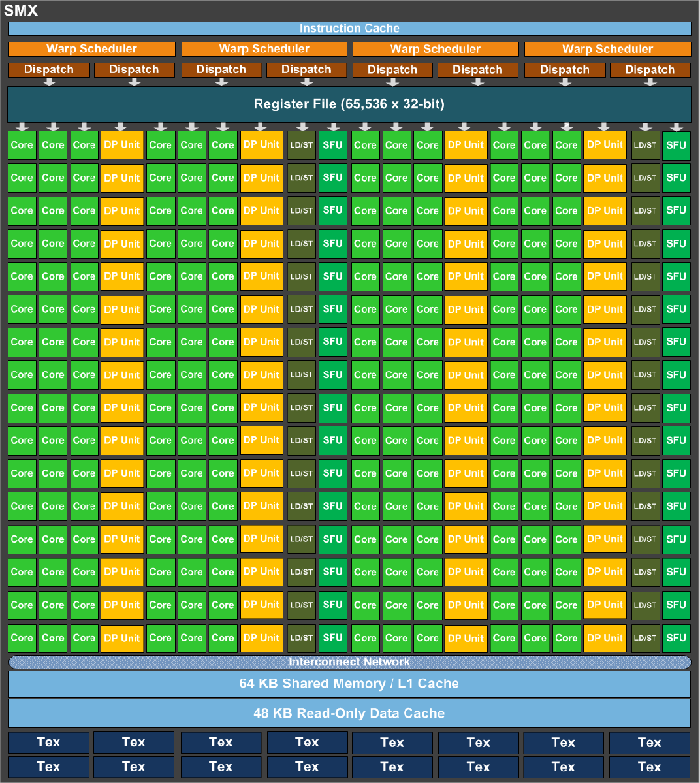
CUDA Execution Model
Warps
warp
kernel<<<4, 256>>>(pointer1);
warp
warp
256 threads
256 threads
256 threads
256 threads
warp
warp
warp
warp
warp

Slide 37
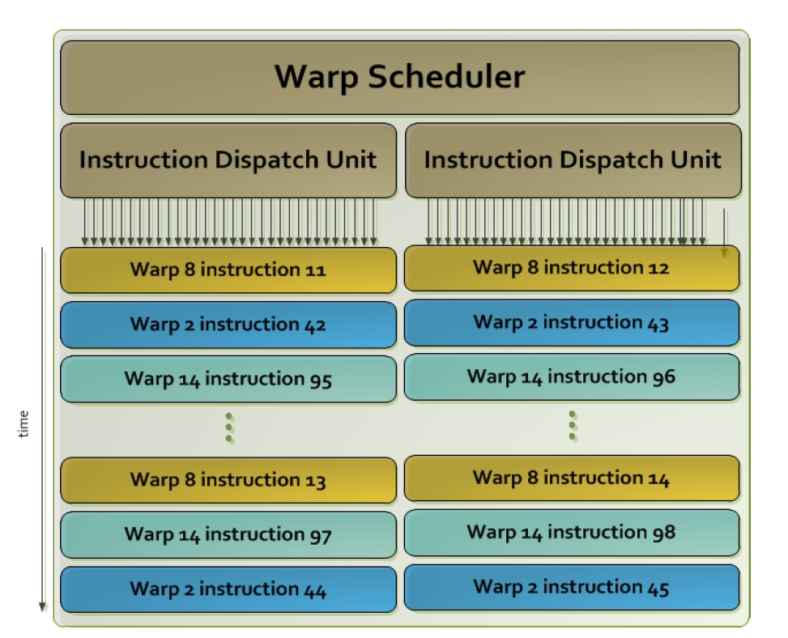
CUDA Execution Model
Warps
4 warp schedulers
Enabling 4 warps to be issued and execute at the same time
two independent instructions per warp can be dispatched each cycle.
Each SM can issue a maximum of 64 warps (e.g. a total threads = 64 * 32 = 2048 threads resident in the SM)

Slide 38
CUDA Execution Model
Warps
Active block: when resources such as registers and shared memory have been allocated to it.
Active warp: warps that belong to the active blocks
Selected warp. Warp that is actively executing
Eligible warp. Warp that is ready for execution but is not currently executing.
Stalled warp. Warp that is not ready for execution.

Slide 39
CUDA Execution Model
Warps
Number of active warps will be limited by physical resources.
if a warp is idle for any reason, SM is free to schedule another warp (from any thread-block that exist already on the SM).

Slide 40
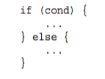
CUDA Execution Model
Warp Divergence
All threads on a warp MUST execute the same instruction.
What happen when there is a branch behavior?
CPU
It has complex hardware to specifically handle branch prediction
GPU
No complex branch prediction. Stalling of threads in a warp

Slide 41
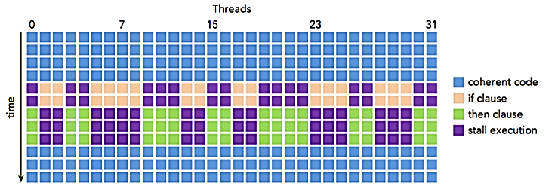
CUDA Execution Model
Warp Divergence
Avoid branch divergence!
Stalling threads is never a good thing
Only threads on the same warp can decrease performance by divergence

Slide 42
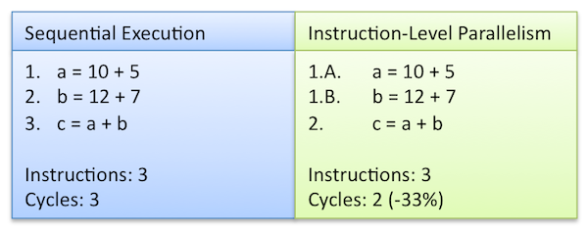
CUDA Execution Model
Other Notes
Instruction Level Parallelism
Instruction on the single thread are pipelined to leverage Instruction Level Parallelism( ILP), in addition to the thread level parallelism

Slide 43
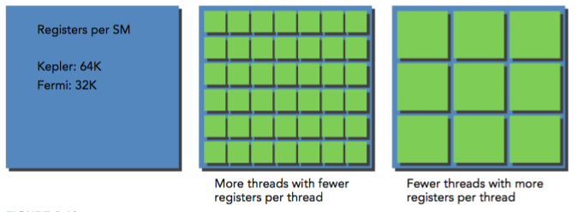
CUDA Execution Model
Other Notes
Resources on a local context:
Program Counters
Registers
Shared Memory
NOTE: If there is not enough resources for at least one block then the launch of the kernel will fail

Slide 44
Profiling Tools

Slide 45
Profiling Tools
Measuring Performance
Why do we use GPUs?
Performance
How do we measure performance?
We measure execution time.
Use event handlers provided by CUDA.

Slide 46

Profiling Tools
CUDA Events
Specific data types:
Using the data types to measure time:
//Time variables
cudaEvent_t start, stop;
float time;
cudaEventCreate(&start);
cudaEventCreate(&stop);
Second parameter associated to stream, usually stream 0
cudaEventRecord(start, 0);
// Put your code here…. (Kernel call)
cudaEventRecord(stop, 0);
cudaEventSynchronize(stop); // Wait for event to happen
// Display time
cudaEventElapsedTime(&time, start, stop);
printf("Parallel Job time: %.2f ms", time);

Slide 47
Profiling Tools
CUDA Events
//create events
cudaEvent_t event1, event2;
cudaEventCreate(&event1);
cudaEventCreate(&event2);
//record events around kernel launch
cudaEventRecord(event1, 0); //where 0 is the default stream
kernel<<<grid,block>>>(...); //also using the default stream
cudaEventRecord(event2, 0);
//synchronize
cudaEventSynchronize(event1); //optional
cudaEventSynchronize(event2); //wait for the event to be executed!
//calculate time
float dt_ms;
cudaEventElapsedTime(&dt_ms, event1, event2);

Slide 48
Profiling Tools
Profiling Performance
Now that we can measure performance, what if our code is taking too long?
How can we improve our code?
Best guideline
Use profiling tools

Slide 49
Profiling Tools
NVPROF
Command line profiler
Compute time in each kernel
Compute memory transfer time
Collect metrics and events
Support complex process hierarchy’s
Collect profiles for NVIDIA Visual Profiler
No need to recompile

Slide 50
Profiling Tools
NVPROF
Compile binary with some information so nvprof / nvvp can track line numbers

Slide 51
Profiling Tools
NVPROF
Instructions:
Collect profile information for the program by running
nvprof ./exec
View available metrics
nvprof --query-metrics
View global load/store efficiency
nvprof -metrics gld_efficiency,gst_efficiency ./exec
Store a timeline to load in NVVP
nvprof -o profile.timeline ./exec
Store analysis metrics to load in NVVP
nvprof -o profile.metrics --analysis-metrics ./exec
Timeline of CUDA runtime calls, kernel execution times, etc.
Basically no run time overhead
Detailed performance data from each kernel execution. Large run time overhead

Slide 52
Profiling Tools
NVVP

Slide 53
Profiling Tools
NVVP
Note: We will not use NVVP today (or tomorrow)
Instructions
Import nvprof profile into NVVP
Launch nvvp
Click file/ import/ nvprof/ next/ single process/ next /browse
Select profile.timeline
Add metrics to timeline
Click on 2nd browse
Select profile.metrics
Click finish
Explore timeline
Control + mouse drag in timeline to zoom in
Control + mouse drag in measure bar (on top) to measure time

Slide 54
Takeaways
How to get close to peak performance?
Potential for floating point performance on GPUs is huge
Integers less so
Difficult to achieve!
Use memories efficiently:
Avoid unnecessary data transfers
Keep data being accessed often close to the processing elements
Use registers and shared memory
Avoid control flow divergence
Very few if statements

Slide 55
Takeaways
Writing a CUDA kernel is becoming easier, but getting good performance is not.
Know the tools you have available
Profiling is key to performance
Fitting your application to the GPU memory hierarchy is critical for performance
Resources are not infinite, optimization without thinking about the available resources could adversely affect performance.

